Slide 1
New York Tech
Operations Management
Term Project
(QANT 630)
(Integrating Techsoft’s New Vision Graphics Card into the Supply Chain)
Group 8
Adriana Montenegro
Ayesha Fatima
Behnaz Islamian
Ishrat Rahman
Jorge Galindo

Slide 2
Executive Summary
2
2
1- TechSoft is an innovative firm in the sector of graphics cards, with products that are around 10% smaller than competitors, and a B2B market strategy.
2- One of the company's primary benefits is its COGS, which is cheaper than comparable models despite being up to date.
3-TechSoft’s products are manufactured in Singapore and southern Germany, and they are delivered to consumers in North America and Europe with 98 percent customer satisfaction rate and four major suppliers with plans to limit to two.
4- The key issue for this firm is the high supply chain expenses, which impacts product prices.
5- Due to the high cost of capital, outsourcing is not an option.
6- Hence, reducing warehouse space by 4% and savings on shipping and transportation would bring huge savings and efficiency.
7. Analysations revealed that the factory has an overproduction of vision cards which can be altered too.

Slide 3
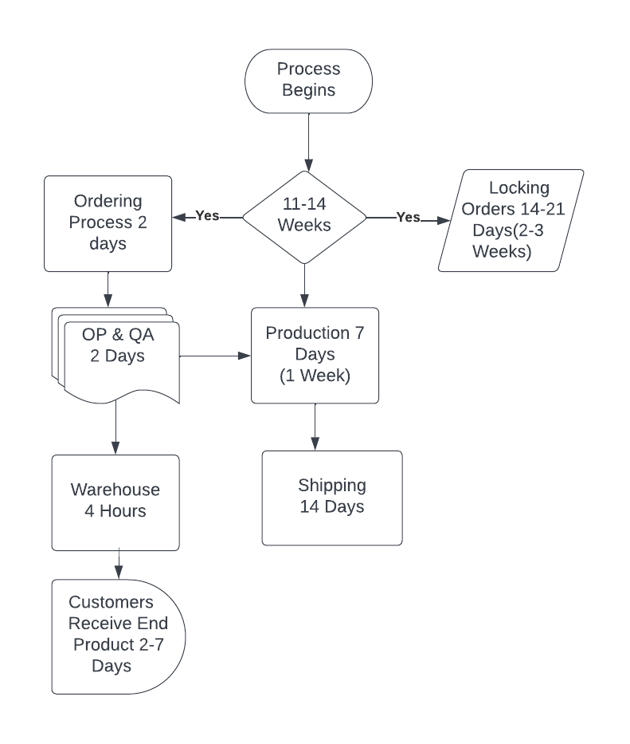
Current Supply Chain Process Map
3
3

Slide 4
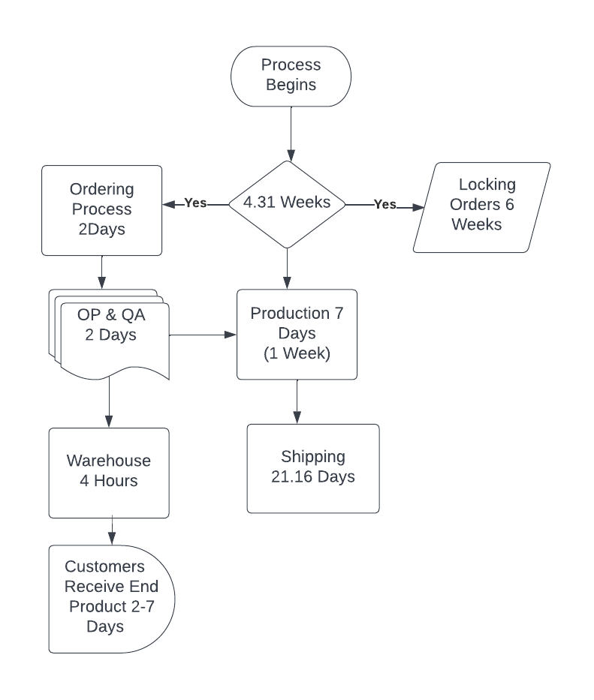
Recommended Supply Chain Process Map
4
4

Slide 5
Customer Survey Analysis
5
5
Question | Yes |  | No |  |  | Yes |  | No
What is your order lead time? | Category A (95%) | Category B (90%) | Category A | Category B |  | A 95% | B 90% | A 95% | B 90%
Customers willing to submit/freeze orders 6 weeks before receipt | 153 | 44 | 2 | 1 | 200 | 77% | 22% | 1% | 1%
Customers willing to submit/freeze orders 4 weeks before receipt | 152 | 42 | 3 | 3 | 200 | 76% | 21% | 2% | 2%
Customers willing to submit/freeze your orders 2 weeks before you receive them? | 50 | 42 | 105 | 3 | 200 | 25% | 21% | 53% | 2%
Customer Service level | Acceptable Risk | Safety Stock
90% | 10% | 101
95% | 5% | 130
98% | 2% | 161.91

Slide 6
Supplier Consolidation Analysis
6
6
Fulfillment of Flexit | Fulfillment of Maxo Inc | Fulfillment of Worldcomm | Fulfillment of Nanotech
100% | 96% | 96% | 99%
103% | 103% | 100% | 101%
97% | 100% | 99% | 99%
99% | 100% | 103% | 101%
99% | 103% | 99% | 97%
104% | 100% | 100% | 99%
100% | 96% | 104% | 103%
98% | 104% | 101% | 103%
99% | 104% | 99% | 99%
103% | 100% | 104% | 103%
99% | 100% | 99% | 101%
100% | 95% | 97% | 96%
100% | 100% | 100% | 100%
Factor | Flexit | Maxo Inc | Worldcomm | Nanotech
Quality | 5 | 3 | 3 | 4
Price | 3 | 4 | 5 | 3
Service | 5 | 4 | 5 | 4
Delivery | 4 | 4 | 3 | 4
TOTAL | 17 | 15 | 16 | 15
20 | 85% | 75% | 80% | 75%
Category | 1 | 3 | 2 | 3

Slide 7
Supplier Consolidation Analysis
Suppliers are within agreement of service levels.

Slide 8
Transportation Analysis
8
8
Current Situation
Type of Transportation | Demand | Cost | Total Cost
Air Expedited | 312.00 | 6.5 | 2,028
Domestic Route - Express | 312.00 | 6.75 | 2,106
Asian Plant to Warehouse | 312.00 | 0.01 | 3
Total Current Cost |  |  | 4,137
Proposed Situation
Type of Transportation | Demand | Cost | Total Cost
Asian Warehouse to North America - Sea | 312.00 | 2.19 | 683
Domestic Route - Ground | 312.00 | 2.3 | 718
Asian Plant to Warehouse | 312.00 | 0.01 | 3
Total Current Cost |  |  | 1,404
Savings |  |  | 2,733
Difference |  |  | -66%

Slide 9
Warehouse/Inventory Analysis
9
9
Warehouse Facility | Singapore, SG
Area (SqM) | 15000
Monthly Operating Costs (Per SqM) | 2.3
Handling Costs ($/per Item) | 1.95
% of Warehouse Dedicated to Vision Card | 35%
Current warehouse cost
$ 12,075.00
Warehouse Facility | Singapore, SG
Area (SqM) | 15000
Monthly Operating Costs (Per SqM) | 2.3
Handling Costs ($/per Item) | 1.95
% of Warehouse Dedicated to Vision Card | 31%
Proposed warehouse cost
$ 10,764.00

Slide 10
Operation Cost Analysis
10
10
Current Warehouse Cost $ 12,075
Proposed Warehouse Cost $ 10,764
Proportion of Vision Cards in Production 31%
Set up cost for Vision Card 9
Total Set Up Cost 30
Current Shipping Cost: $4,137
Proposed shipping cost: $1,404

Slide 11
Findings
The average number of products sold last 12 weeks are 311.42.
From the graph, we can see that the total sales curve is negative, and the slope is -0.0105. This indicates that the trend of total sales of A and B in the previous quarter is negative.
From the trend lines, we can predict that with every coming week (1 unit of week), the sales will drop by 0.0105 units. And from the R square value (9.06^(-7)), we cannot predict the vale from trendline. Usually, the perfect trendline has an R square value of 1.
From the graph, we conclude that the trend is negative.
As the trendline is negative, it is going to affect the sales negatively. So Techsoft will need to act accordingly by keeping a short amount of oversupply, as the slope of the curve is minimum (-0.0105).

Slide 12
Conclusion
12
12
Major findings:
Biggest saving: Shipping and transportation. Currently, they are shipping with an expensive system and we are proposing the cheapest that is in line with lead time
Customer survey: 99% of clients are willing to freeze orders 6 weeks out
Supplier information: All suppliers are within the established service levels (refer to graphs with UCL and LCL)
Minor findings:
Could reduce warehouse space by 4%
The factory has an overproduction of vision cards

Slide 13
Recommendation
13
13
Shipping and transportation costs can be reduced
Decreasing Share of warehouse to 31%
Vision cards production can be reduced based on the forecasting
Customer survey reveals that the orders can be freezed 6 weeks out
Curating a certain amount for monthly handling costs

Slide 14
Appendix
14
14
SafetyStock Calculation 90
Average Demand W | 312.00
Sigma d | 38.04
Lead time | 4.31
Service Level | 0.90
Acceptable risk | 0.10
z | 1.28
Sigma dlt | 78.98
Safety Stock | 101.09
SafetyStock Calculation 95
Average Demand W | 312.00
Sigma d | 38.04
Lead time | 4.31
Service Level | 0.95
Acceptable risk | 0.05
z | 1.64
Sigma dlt | 78.98
Safety Stock | 129.53
SafetyStock Calculation 98
Average Demand W | 312.00
Sigma d | 38.04
Lead time | 4.31
Service Level | 0.98
Acceptable risk | 0.02
z | 2.05
Sigma dlt | 78.98
Safety Stock | 161.91

