Slide 1
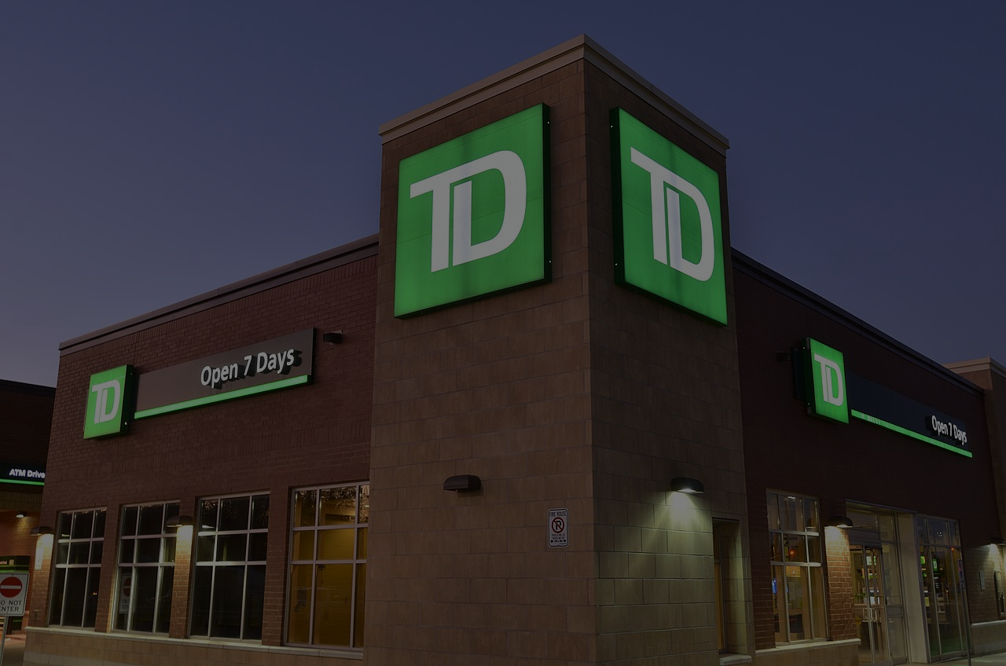
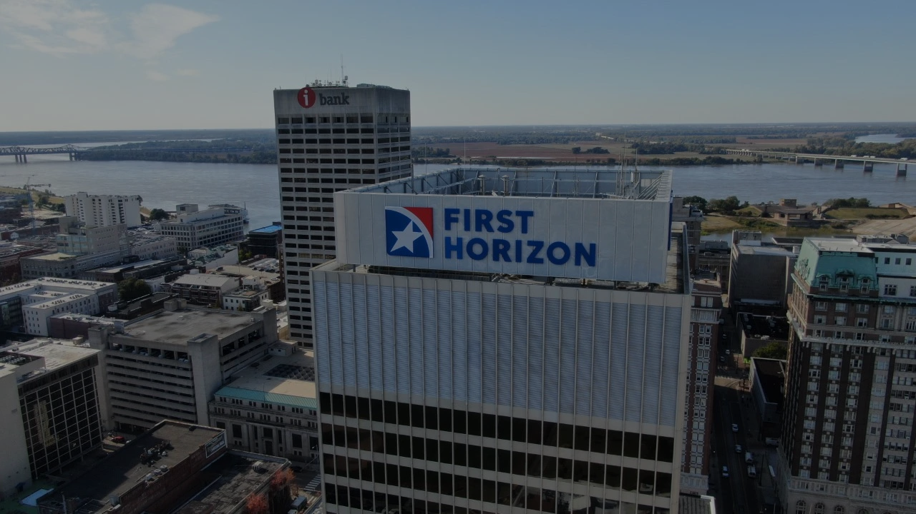
Case study
TD Bank & First Horizon
September 4, 20XX
Adriana Montenegro
Ayesha Fatima
Behnaz Islamian
Jorge Galindo Torices
Qiang Xu

Slide 2
Introduction
TD Bank
The Toronto-Dominion Bank is a Canadian multinational banking and financial services corporation headquartered in Toronto-Ontario. TD ranks amongst the 10 largest banks in North America by assets and serves more than 26 million customers with over 25,000 employees and deep roots dating back more than 150 years. TD’s three key businesses operate in a number of locations in financial centre’s around the globe.
Canadian Retail:TD Canada Trust, Business Banking, TD Auto Finance, TD Wealth, TD Direct Investing and TD Insurance
U.S. Retail:TD Bank, America’s Most Convenient Bank, TD Auto Finance (U.S.), TD Wealth (U.S.) and TD’s investment in Schwab
Wholesale Banking:TD Securities
TD also ranks among the world's leading online financial services firms
Has more than 15 million customers and CDN$1.7 trillion in assets as of October 31, 2021
TD Bank is one of the 10 largest banks in the U.S.,

Slide 3
SWOT analysis TD Bank
Strengths
Brand reputation
Extensive network
Wide range of portfolio
Goods returns on capital expenditure
Strategy and framework
Consistent earnings growth and dividend history
Weaknesses
Dependence upon third-party service providers
Customer service
Website and app outages leading to customer outages
Need to Invest More in New Technologies
Opportunities
Operating in attractive markets with huge growth potential
Several Acquisitions and Expansion in the US
Rise in dividend
Development of Technology
Threats
Highly competitive financial services market
Impact of COVID-19 outbreak
Economic stability being shook
Soaring oil prices and effects due to war on businesses
Improper disclosure of terms and lack of customer service
Regulatory Charges

Slide 4
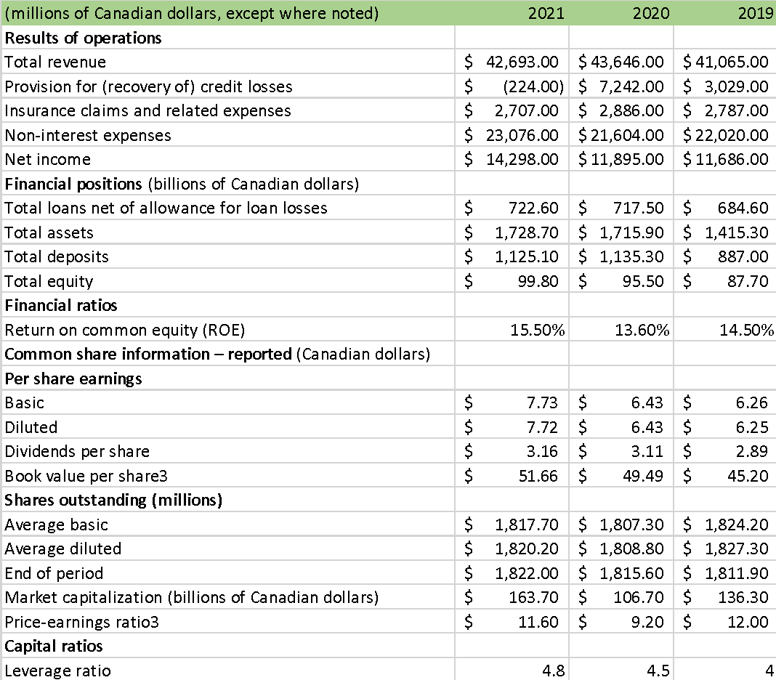
TD Bank Financial Information

Slide 5
Financial Highlights
Results of operations - Net Income had a 20% growth YoY 2021 - 2020. Recovery of credit losses along with not having to provision for potential credit losses as in the previous years, which had a -103% in comparison with the previous year.
Financial positions - 0.75% increase in their total loans and a 4.5% increase in total equity, primarily due to retained earnings.
Financial ratios - ROE had a 13.9% increase YoY mainly due to the increase in Net income.
Shares outstanding - The Market Capitalization grew by 53% in comparison to 2020 to finish at %163.7 Billions and recovering from the -21% decline from 2019 - 2020.
The P/E ratio had a 26% increase from previous year to $11.6. (stock price / EPS TTM).
Capital ratios - With a 4.8 leverage ratio, TD Bank is within the industry standard of the top banks in Canada, which varies from 4.7 to 5.1.

Slide 6
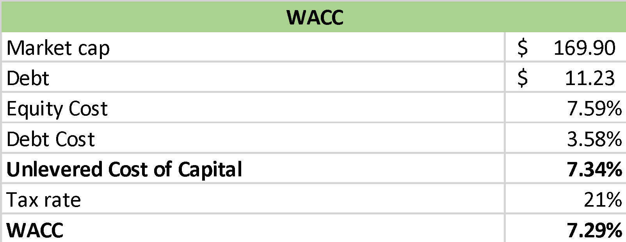
CAPM & WACC
Capital Asset Pricing Model - CAPM
Risk free int rate (Can 20 yr bond) | 2.83%
Market risk premium | 5.60%
Beta 5 y (from Yahoo Finance) | 0.85
CAPM | 7.59%
CAPM - The risk-free rate was taken from the Canada 20 yr bond, a market premium of 5.6% was assumed, as a result TD’s Cost of Equity was 7.59%.
WACC - Taking into consideration the cost of debt at 3.58% and the effective tax rate paid by TD Bank in 2021 the WACC comes at 7.29% which is the cost of equity and debt.

Slide 7
Total Payout Model
For the Net income growth rate we adjusted to match the dividend growth rate. As seen on the Financial Highlights TD was able to increase its Net Income by 20% YoY 2020 - 2021 which we had to adjust to a more conservative growth rate.

Slide 8
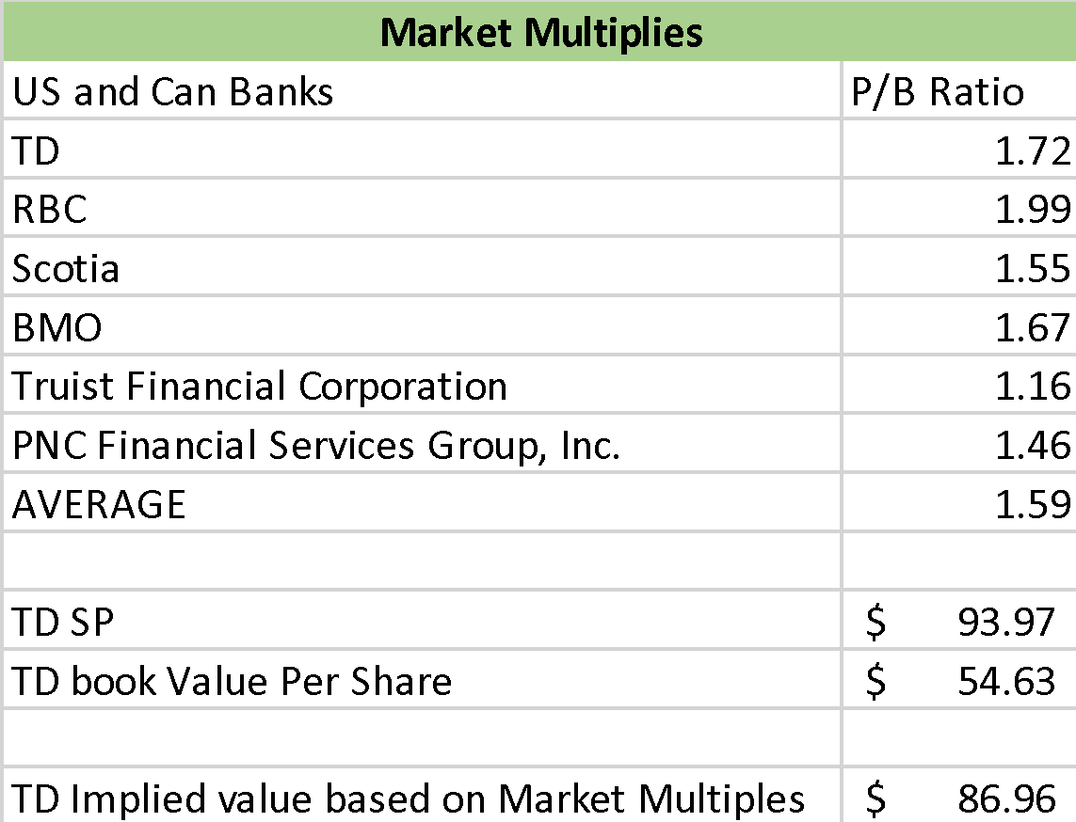
Market Multiples
Under a Market Multiples - P/B ratio measures the market’s valuation of a company relative to its book value.
Comparison between TD’s P/B ratio with similar Canadian and US banks.
As we can notice from the implied value TD Bank stock is slightly overvalued in comparison to its peers.

Slide 9
Introduction
First Horizon
Horizon Bancorp (IN) is a banking holding company established in the United States. It provides commercial and retail banking services, corporate and individual trust and agency services, and other banking-related services. Commercial loans, real estate loans, mortgage warehouse loans, consumer loans, and other credit facilities are also available from the organization. Furthermore, the organization offers advances, loans, term loans, and overdrafts for a variety of commercial objectives, including business development, the purchase of machinery and equipment, business mortgages, and others.

Slide 10
SWOT analysis First Horizon
A broad geographic presence
A track record of success in consumer-driven innovation
High margins as compared to competitors
Strengths
Weaknesses
First Horizon per-unit revenue is declining.
market share is decreasing despite rising revenues
Low investments in customer-oriented services
Rapid Economic Growth
Regional Cooperation
Customers’ tendency to higher-end items
Opportunities
Threats
Trade deal between US and China
Demographic shifts
International and local competitors' challenges
Increasing the technological knowledge of local players

Slide 11
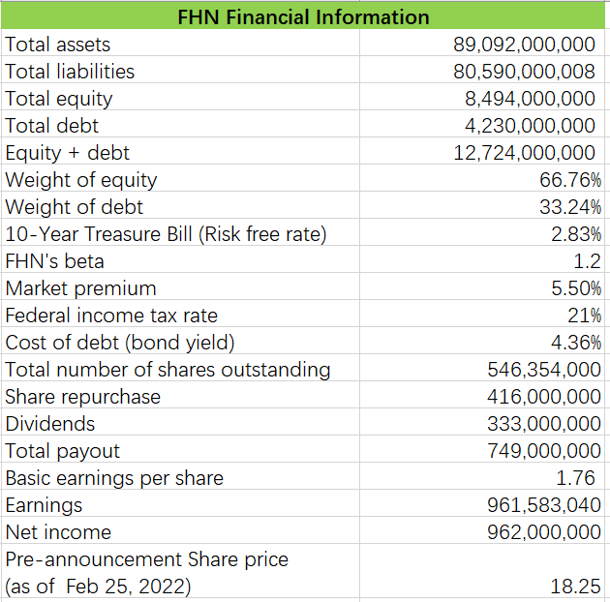
First Horizon Corporation Financial Information

Slide 12
Debt Size Determination
Though deposits are counted as liabilities, the interest rate that FHN pays for deposits is very low (0.22%, total 170M interest paid out of 75B deposits). Therefore, only corporate bonds issued are considered in calculating debt size.

Slide 13
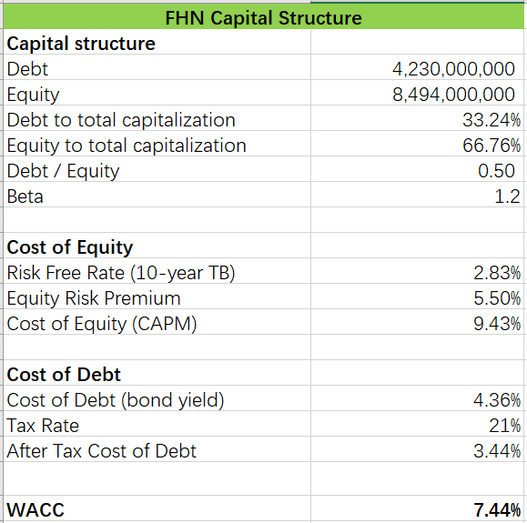
Capital Structure

Slide 14
Key Performance Indicators

Slide 15
Multiple Valuation

Slide 16
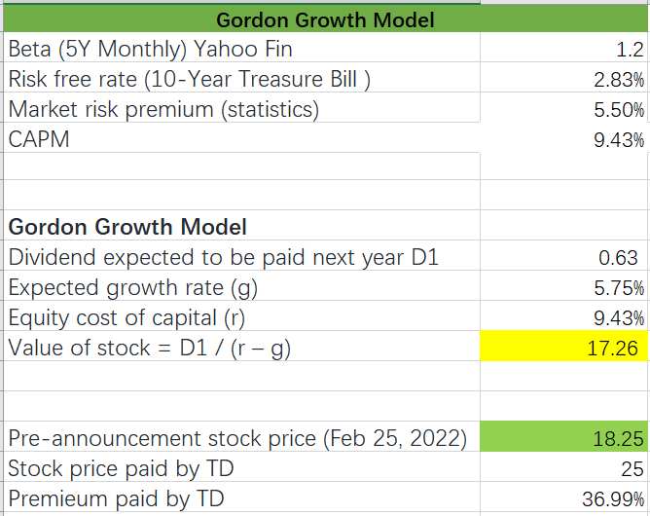
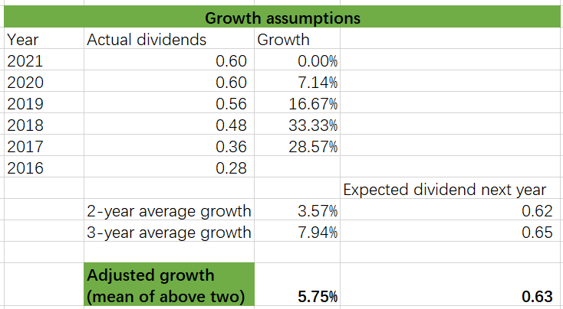
Gordon Growth Model

Slide 17
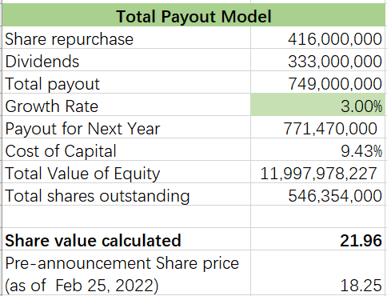
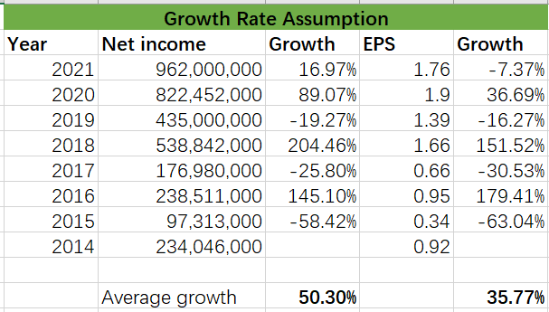
Total Payout Model

Slide 18
Inference
FHN has a strong financial performance compared with similar banks.
Its PE and price/book ratio are near industry average.
Its pre-announcement stock price of $18.25 was within the estimated range from $17.26 (growth model) and $21.96 (payout model).

Slide 19
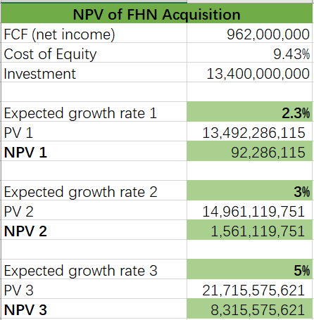
Acquisition NPV Calculations

Slide 20
Assumptions in NPV Calculations
Free cash flow: net income of current year
Growth rate: both net income and EPS growth rates are too high and unsustainable, so three grow rates are assigned to calculate different NPVs. A positive NPV can be achieved when the growth rate is larger than 2.3%.

Slide 21
Merger and Acquisition Terms
TD purchase First Horizon in an all-cash deal valued at US$13.4 billion, or US$25.00 per First Horizon ordinary share.
TD anticipates overall merger and integration expenses of US$1.3 billion, mostly in the first two years after the transaction closes.
The transaction is scheduled to conclude in the first quarter of TD's fiscal year 2023, subject to regulatory clearance in Canada and the United States.
If the deal does not conclude before November 27, 2022, First Horizon shareholders will receive an extra US$0.65 per share on an annualised basis.
If the transaction does not close by February 27, 2023, it will be terminated, unless otherwise extended.
TD has also committed to invest $494 million in non-voting First Horizon preferred stock.
The automatic share purchase plan set up for TD’s normal course issuer bid will be terminated automatically in line with its conditions.
In addition, a US$40 million contribution will be made to a First Horizon foundation.
First Horizon intends to submit appropriate documents with the SEC in connection with the proposed transaction, including a proxy statement on Schedule 14A.

Slide 22
Post merge analysis

Slide 23
Synergies
Enhanced Growth Driven by Scale, Distribution and Geographic Reach
Sixth larger bank in the US bank
US$614 b assets, US$469 b deposits, 10.7 million customer
1,560 stores
Expansion into Fast-Growing Adjacent Southeastern U.S. Markets
Five-year projected population growth of 50% higher than the national average
#1 deposit in Tennessee and big presence in Louisiana.
More presence in Florida and the Carolinas
Attractive Financial Returns to TD
Accelerates TD’s long-term earnings growth
Strategic deployment of TD’s excess capital: -10% cost reduction
Culturally Aligned with Consistent Risk Frameworks
Both companies have culture deep commitment to their customers, colleagues and communities
Both companies have strong team

Slide 24
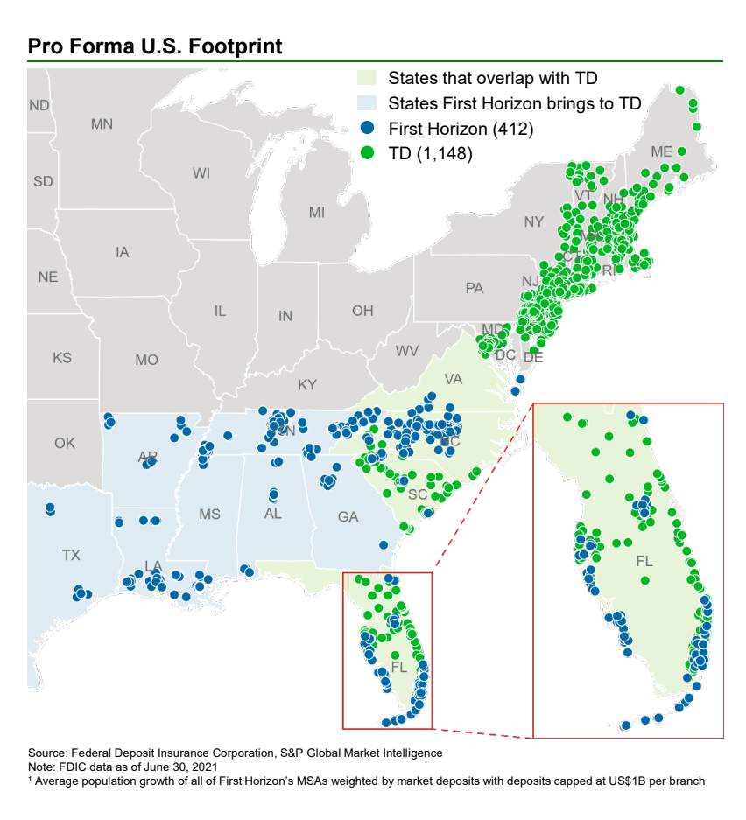

Slide 25
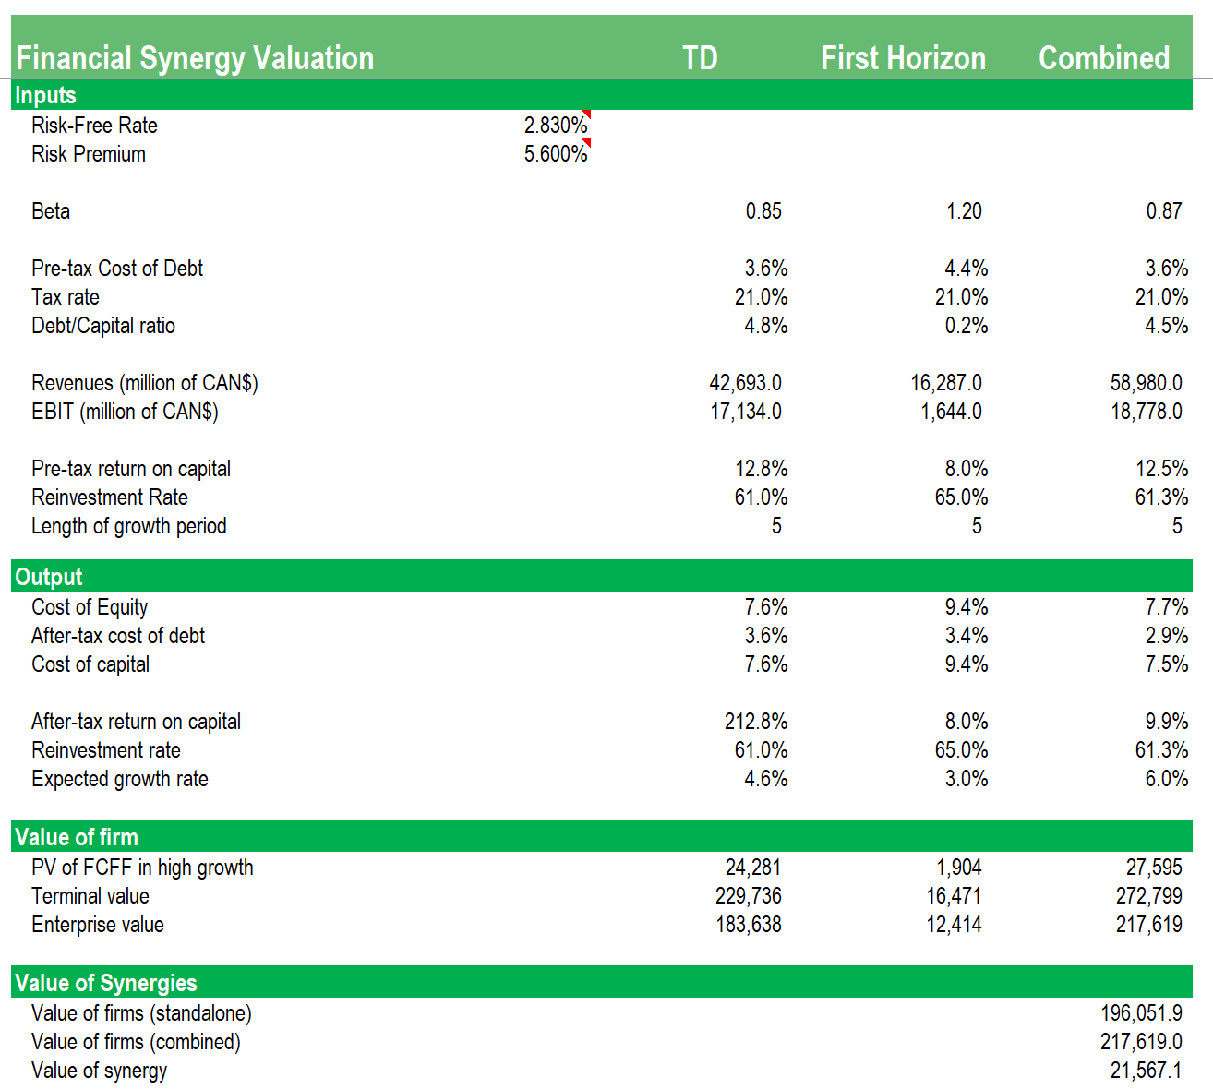
Financial Synergy Valuation

Slide 26
Conclusions
The acquisition by TD Bank of First Horizon will boost its growth in the US as the sixth-largest U.S. bank. Additionally, with a projected population growth that is 50% higher than the national average in the current footprint of First Horizon, TD Bank expects to capitalize on its growth.
As shown before, through the acquisition of First Horizon, both operational and financial synergies are expected. Operational synergies will be approximately US ~$610MM, 45% is predicted to be achieved by 2024 and 100% by 2025.
Finally, the financial analysis made on First Horizon shows that even with a marginal growth rate the NPV of the project is positive; therefore, a profitable outcome is anticipated.

