Slide 1
FAST FASHION - CASE STUDY
MRKT 765
Anurag Narwal | Faizan Kazi | Saksham Rawat | Yash Mukherjee

Slide 2
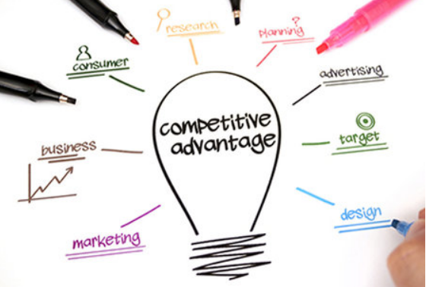
Zara Competitive Advantages
Differentiation & Cost Leadership
Differentiation
Constant product rollout.
Competing directly with high end brands.
Fast fashion model.
Internal manufacturing of trendy and fashionable merchandise
Use of technology to improve customer experience; Interactive fitting rooms, RFID technology to track products
Cost Leadership
Eliminated the need for warehouses
Has a trendy but affordable portfolio of clothes
Only outsources basic line of products, thus reducing the delays of shipments
Saksham

Slide 3
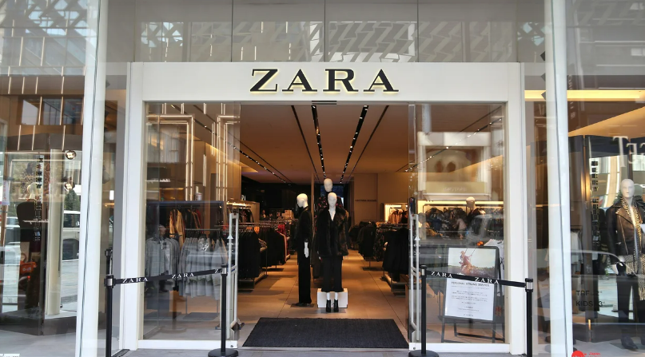
Zara Comparative Advantages
In home design teams and manufacturing of the latest trendy clothes as compared to the competition.
In addition to finished goods, Zara also sources different raw materials to manufacture fashionable merchandise.
Pricing strategy to attract next-gen middle class customers who want trendy but affordable products.
Well positioned factories near stores resulting in shorter lead time, getting brand new design clothes to the store in around 4 weeks.
Saksham

Slide 4
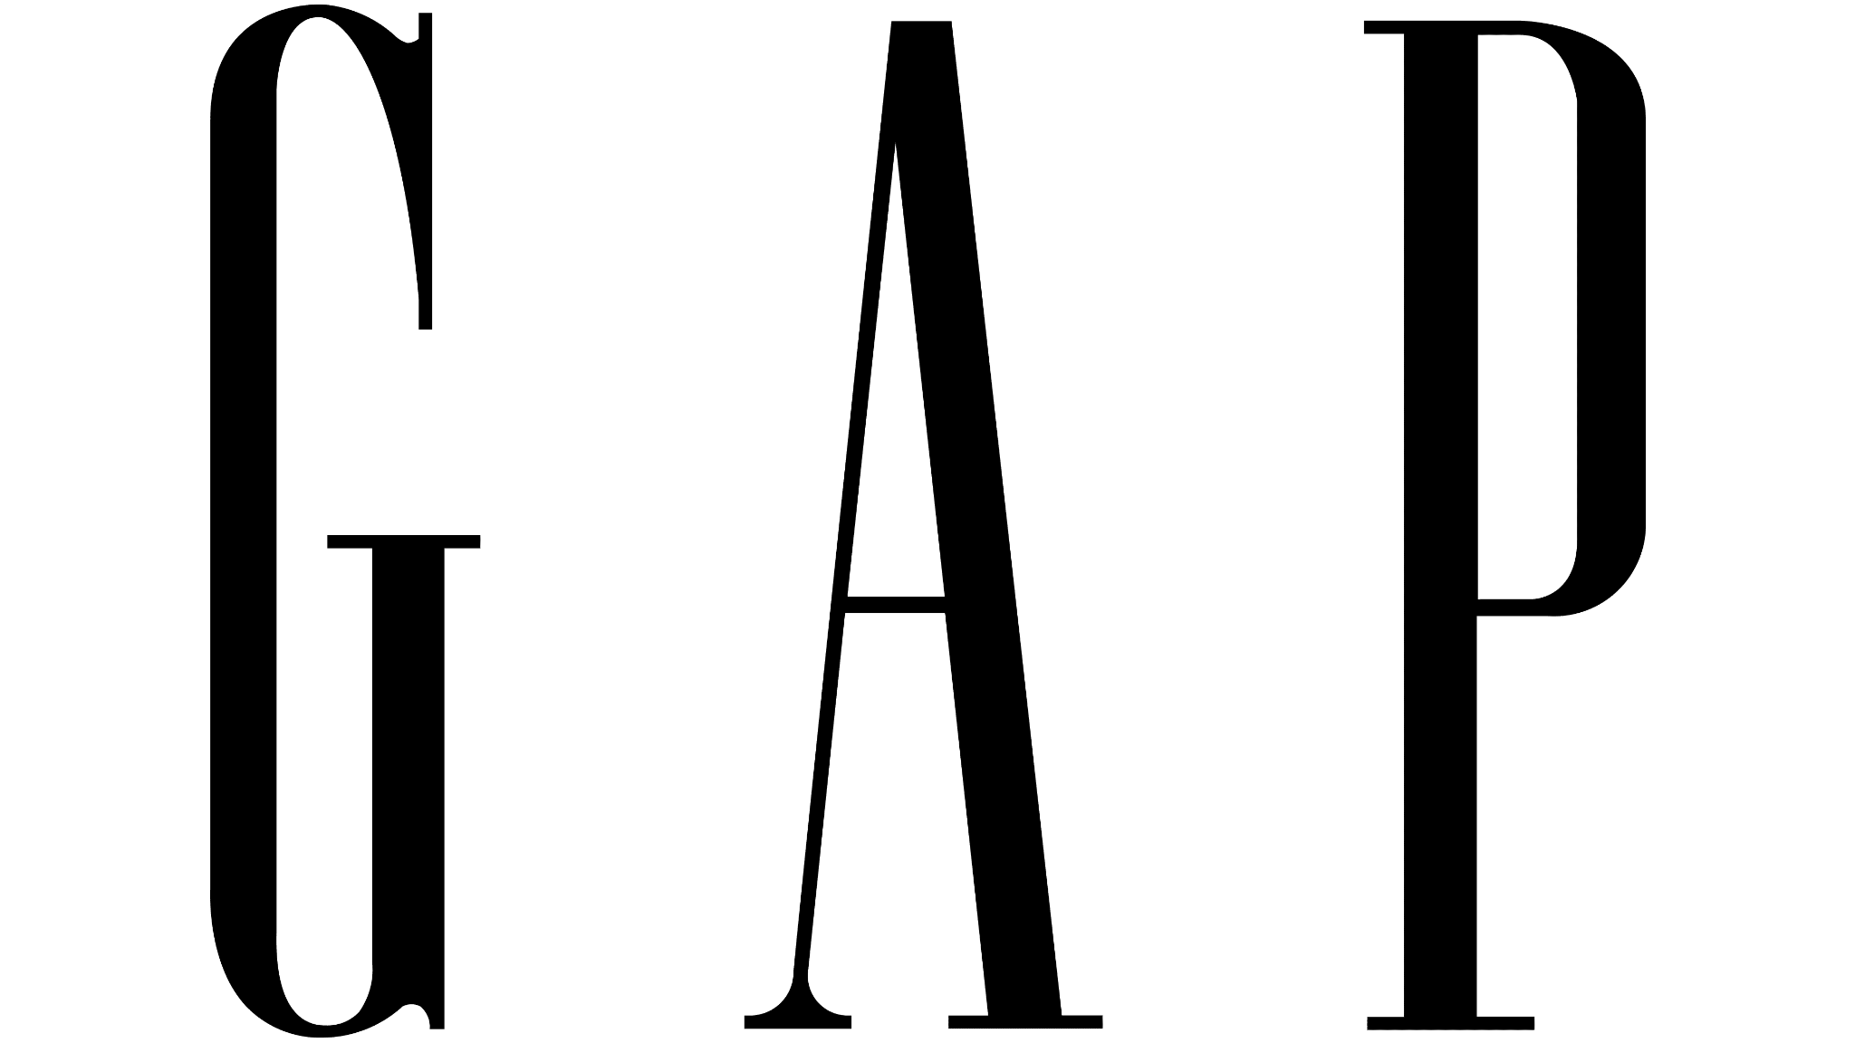
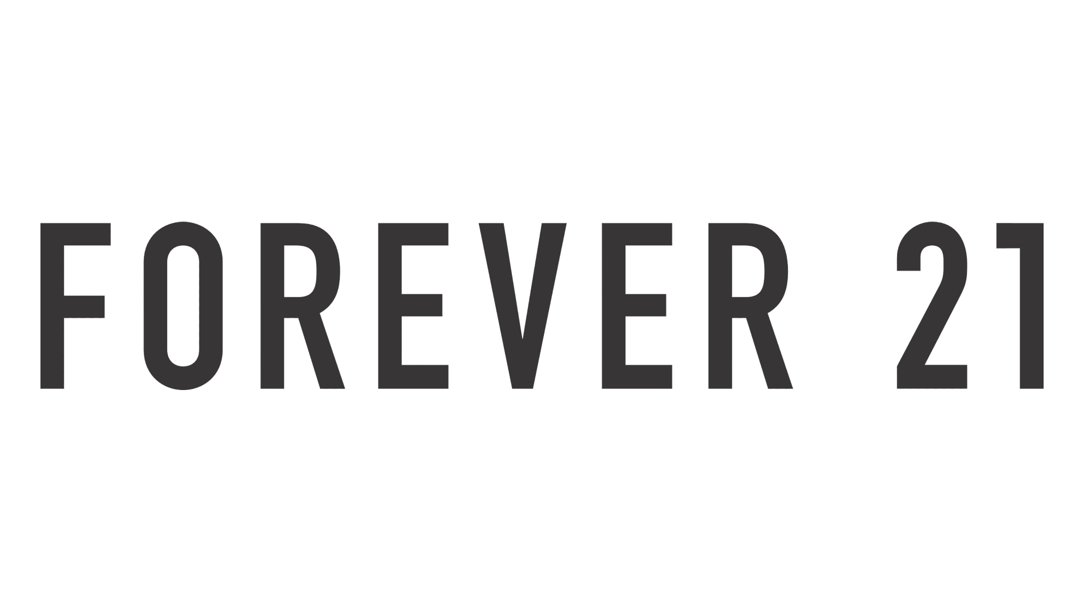
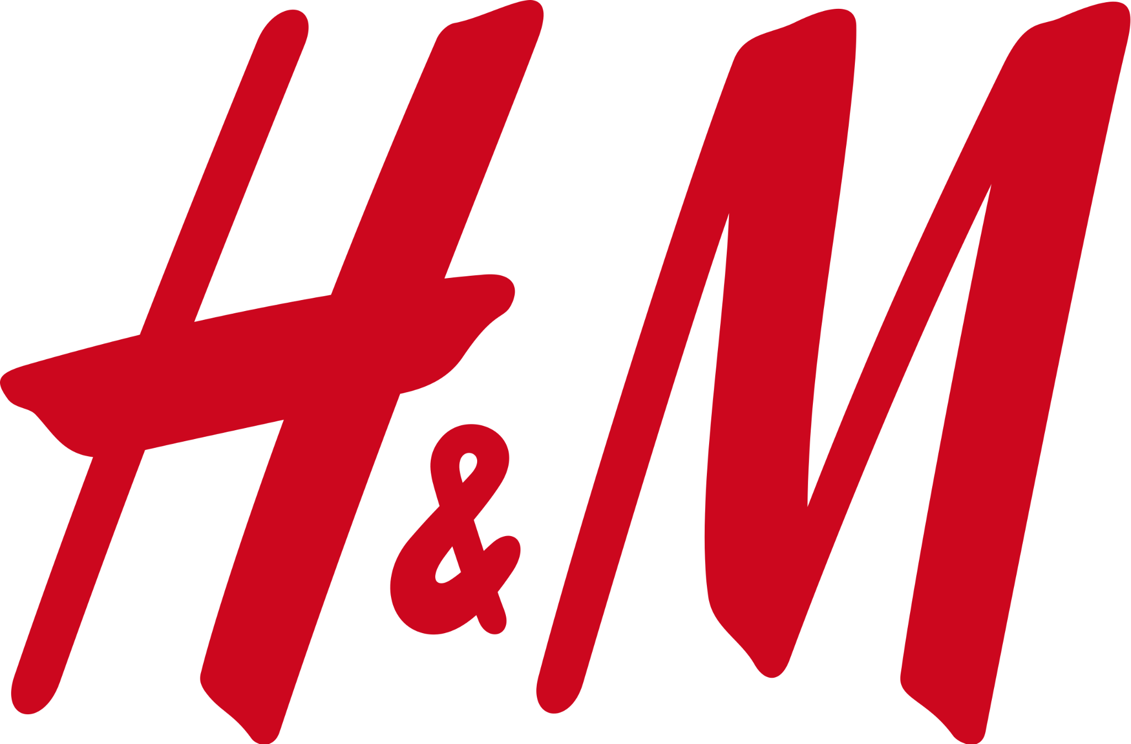
High Price
Basic
Trendy
Low Price
Saksham

Slide 5
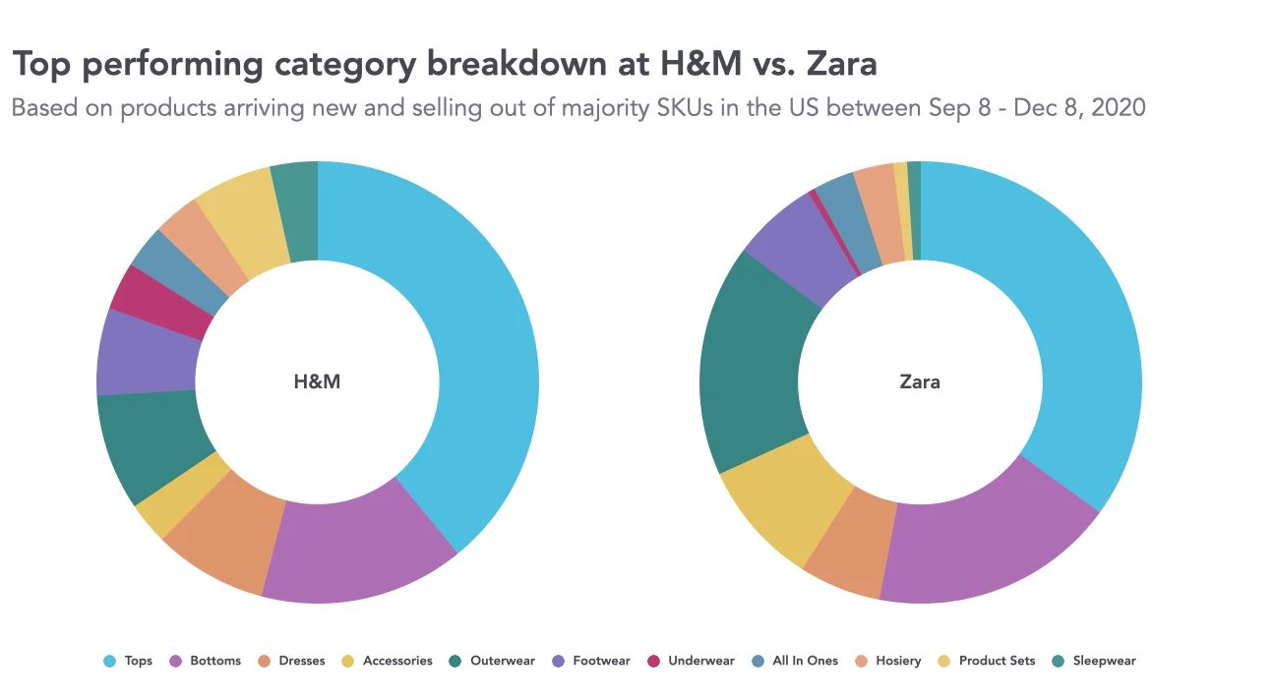
Source: edited.com
Anurag

Slide 6
Key Business Functions for product launch
Strategy
R&D
Marketing
Sales
Finance
Design and product development teams stay updated on fashion trends to manufacture and deliver fast fashion to their customers.
Low spending on marketing, mostly advertising through social media, physical stores (making customers visit frequently), habit forming (repeated purchase) and WOM.
New products every 2 weeks, more styles over more quantity, low discounts-high revenue.
Margin maintenance, country specific pricing.
In-house production by reserving 85% of capacity for in-season adjustments. It helps Zara in flexibility of quantity, frequency, and variety of fashion products.
Centralized order fulfillment platform, quick ship, already priced and ready to sell.
Highly capable on-floor staff to take feedback of what consumer needs and providing demand forecast to the Zara’s 700+ designer team.
Use of RFID technology saving huge on inventory, use of e-commerce platform.
Operational
Production
Logistics & Supply Chain
HR
IT
Anurag

Slide 7
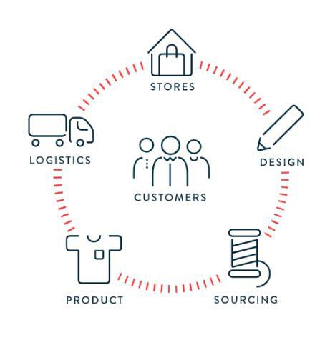
Zara’s Business Functions
SALES
Lower Markdowns
High Profitability
Low unsold Inventory
DISTRIBUTION
Strong & Quick Network
Short Lead time (Twice a week)
Small Batches
Within 24 hours
(European Market)
Within 40 Hours
(American & Asian Markets)
Feedback
Value Creation
R&D and HR
Fashion Inspired
Hottest Trends
Customer’s need & want
Designers & Specialists creates continuous seasonal product development.
Creative teams use variation using fabric and product mix.
PRODUCTION
Vertically Integrated
Limited outsourcing
50% clothing items manufactured during ongoing season.
Just in time manufacturing.
Mass Production
Low Inventory
CENTRALIZED
TECHNOLOGY
RFID
PROCUREMENT
Raw Materials from 50 different markets.
Image Source: Equity Research - Inditex
Anurag

Slide 8
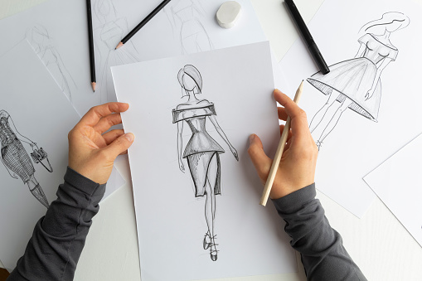
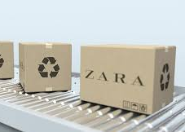
These are important because...
Consumer feedback is received from the point of sale.
Designer team’s creativity helps to achieve rapidly changing market demands.
Use of postponement strategy, modifying the undyed and unprinted raw material to the finished product.
Keeping 50% buffer to be produced in middle of the season gives a upper hand to cope up with hot trends and produce just in time at its high tech factories.
Efficient supply chain and distribution networks helps Zara to ship products at the desired country and store quickly.
Anurag

Slide 9
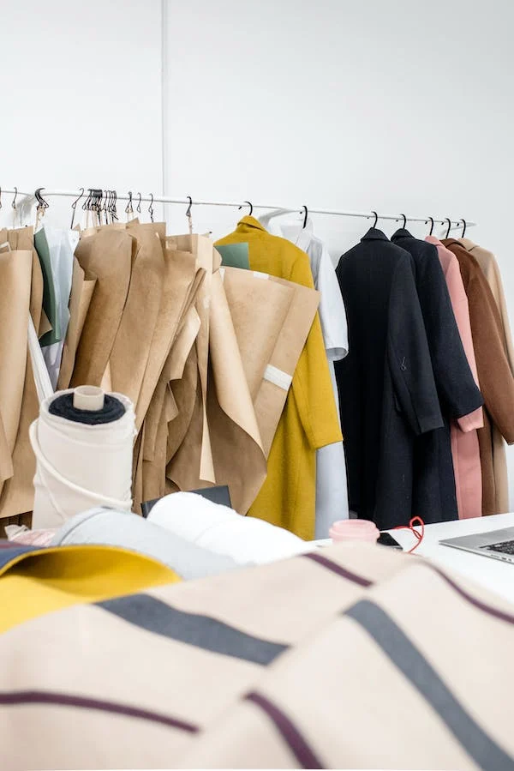
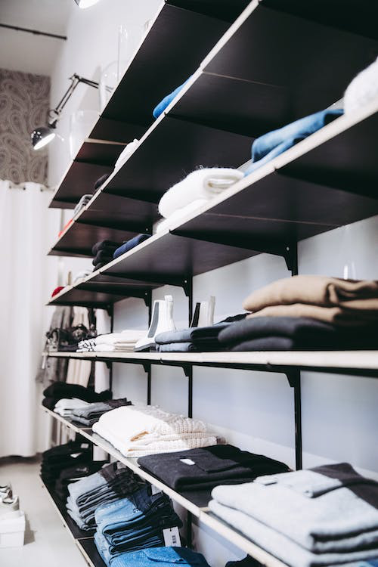
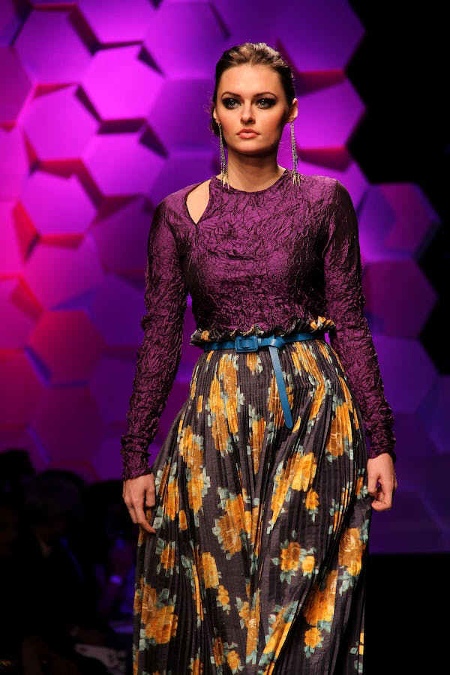
Zara Product Launch Strategy
Ideation
Selection
Distribution
Work on current season designs parallely
Flat hierarchy of design maestros
Consult with product developers, local designers and store owners
Select 1/3rd for production
Allocate to stores based on historical sales, orders received on handheld devices
3
Retailing/Merchandising
5
1
Sourcing
2
4
Prices determined centrally and are not competitor based
0.3% of revenue - media spend
Invest in locations/ storefront
Validation/Research
Sourcing partners also act as trend spotters in regions like Hong Kong
Purchase “undyed” fabric for future use/change in trends
Select a mix of internal and external suppliers for the product
Attend trade fairs, fashion shows
Leverage industry publications, TV, Internet, and film content; trend spotters
Yash

Slide 10
Zara Product Launch - Lean Marketing Canvas
Problem
Solution
Unique Value Proposition
Unfair advantage
Customer Segments
Launch clothing products and collections with a limited amount of time to market
Distribute products across geographies while limiting operational and logistical overheads
Cater to local influences, preferences and pricing structures
Claims of unsustainability
Consult with fashion influencers/designers
Build vertically aligned supply chain
Offer a circular fashion economy
Latest styles, at affordable prices
Styles and pricing adapted to local trends and preferences, influenced by local fashion influencers
“Instant fashion” - Identify and launch products meeting current fashion trends
Capability to operate reverse logistics for future use cases
Teenagers
Young adults
Fashion conscious customers
Price conscious buyers
Early trend adopters
Environment conscious consumers
Next-gen middle class
Key Metrics
Channels
Free
Physical locations
E-commerce/App
Media coverage
Paid
Media spend
Social media+PPC
Sales by SKU/Collection
Sales by location
Customer satisfaction/WoM
Cost Structure
Revenue Streams
Supply chain (incl. Suppliers)
R&D
Real Estate - Lease/Purchase
Personnel (incl collaborations)
Merchandising
Event sponsorship
IT infrastructure
Sale of products - Ecommerce
Sale of products - Brick & Mortar
Lease from franchisees
Sale of assets
Commission from marketplace transactions
Yash

Slide 11
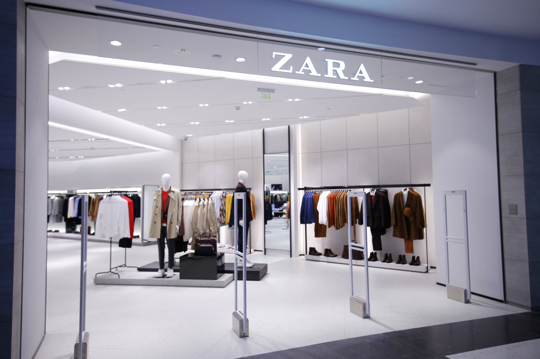
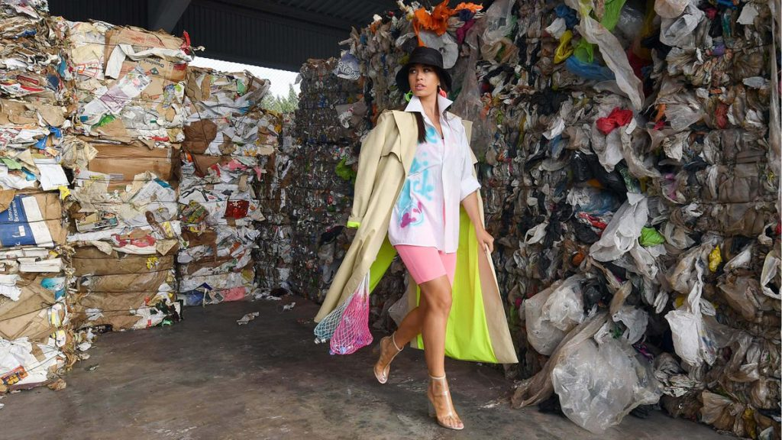
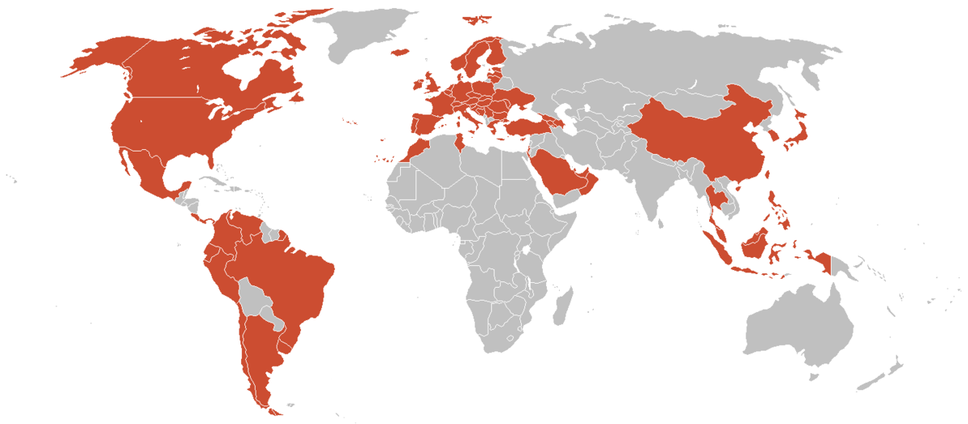
Weaknesses
>. High reliability on Physical stores
>. Massive losses due to Covid-19
>. Balancing fast fashion with sustainability
>. Plenty of waste created
>. Less presence in Asia and United States
>. Only 99 stores in U.S
>.Issues in Work and Labor practices
>. Bad workplace conditions and lack of job security
>. Very less safety stock
>. Best selling products are mostly out of stock
>. Minimum advertising and publicity
>. Lack of information to the public
Faizan

Slide 12
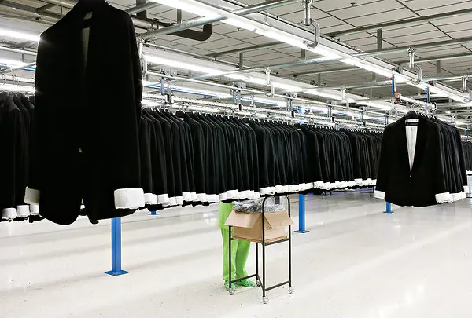
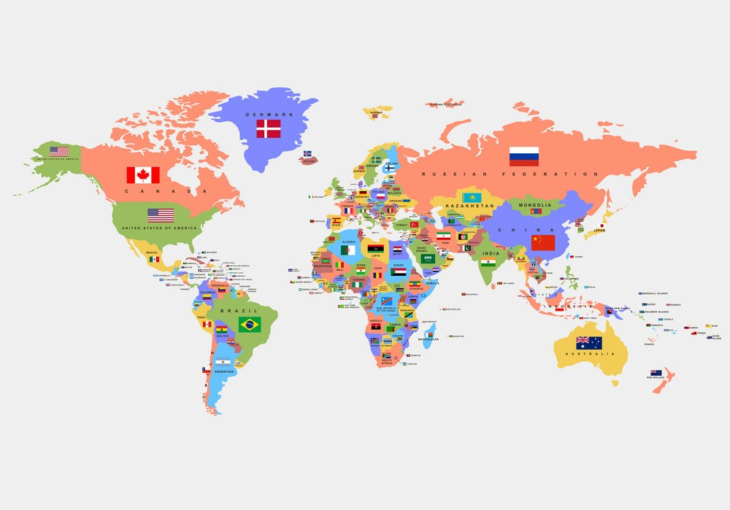
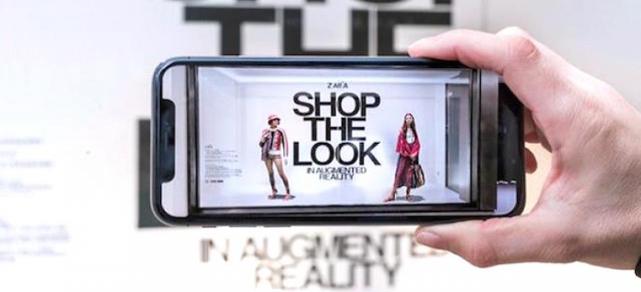
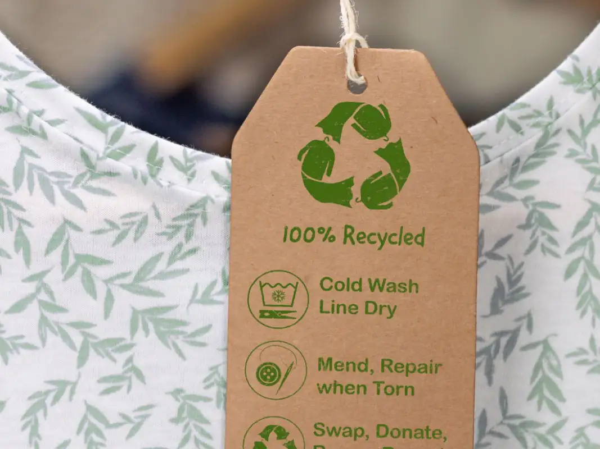
Opportunities and Improvement
>. Quick Delivery cycle
>. Shortening the current cycle of 2-3 weeks
>. Use of Artificial Intelligence
>. Use of predictive analytics and forecasting the demand
>. Expansion in New and Developing markets
>. Better level of saturation in the market
>. Eco-friendly approach
>. 1/3rd of the buyers look for eco-friendly labels on clothing
>. Increase in Influencer marketing
>. Target ting millennials and Gen Z
>. Focus more on E-commerce and online shopping
>. Increased reach and more revenue
Faizan

Slide 13
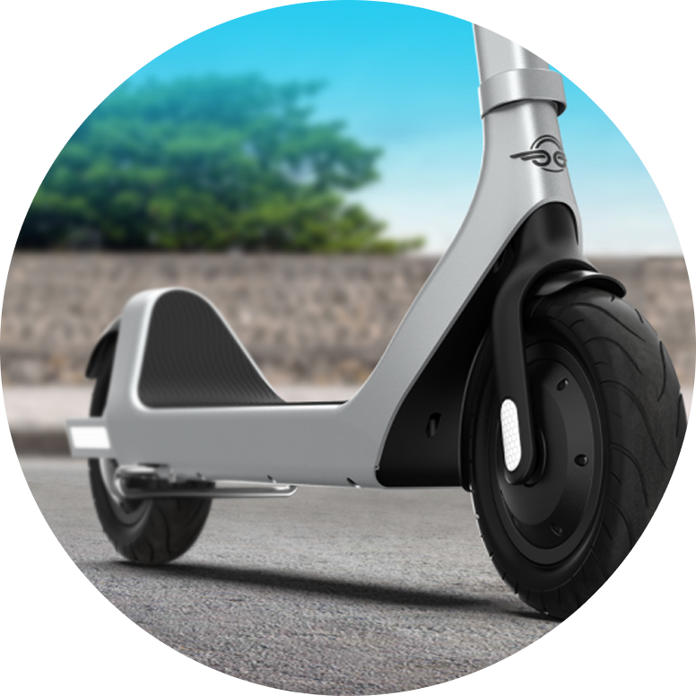
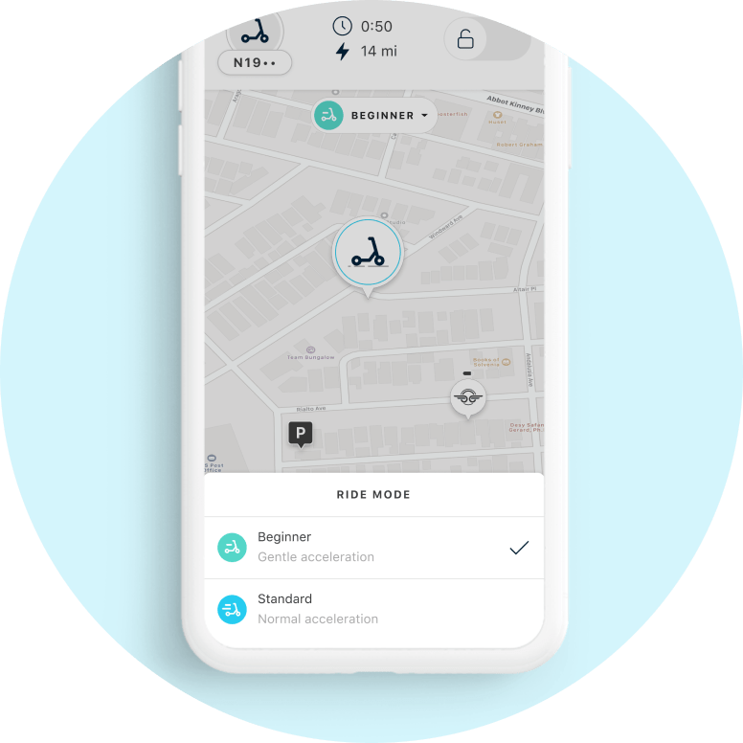
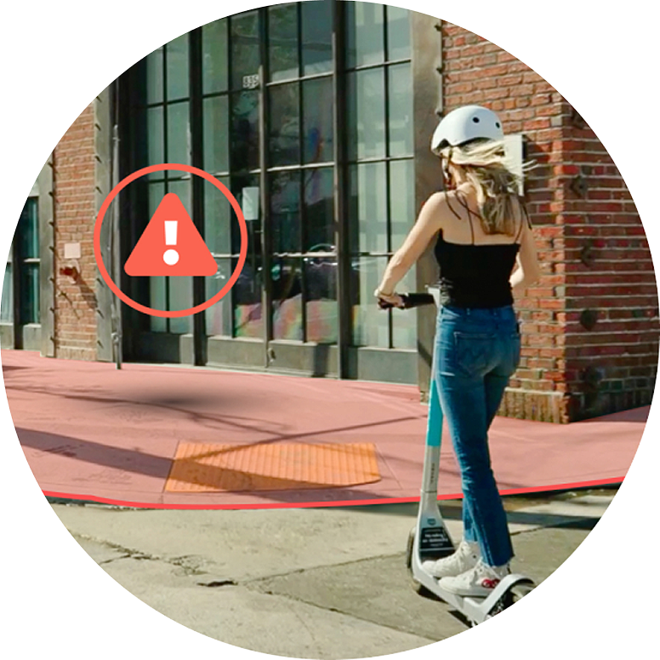
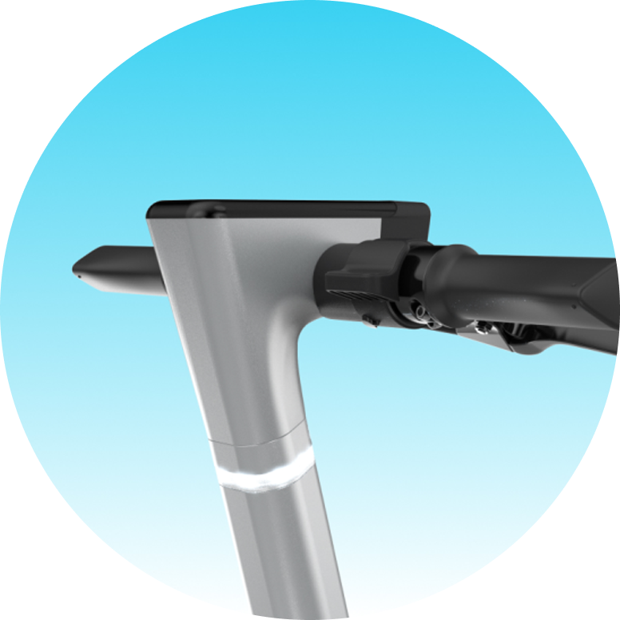
Safety Integration
>. Safe Start
>. Prevents people from riding under influence
>. Skid detection
>. Vehicle diagnostic and sensor indicates if a skid has occurred and prompts service needs
>. Beginner mode
>. Slow acceleration for beginner riders
>. Real time fault detection
>. Sensors automatically detect any issues in real time
>. Smart sidewalk integration
>. Prevents riders from riding on the sidewalk and brings scooter to a stop
>. Autonomous Emergency braking
>. System that makes sure riders can always come to a stop
Faizan

Slide 14
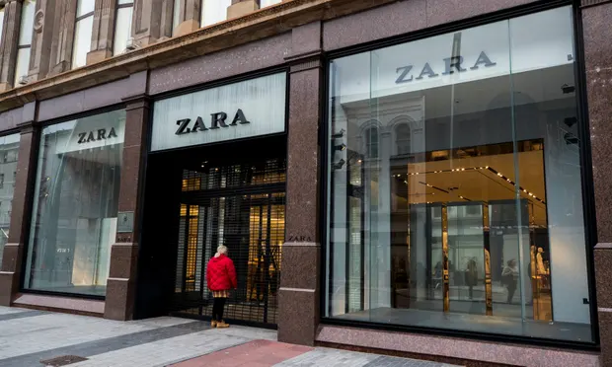
What’s happening now - Building a sustainable online future
The future
Zara has started offering services for repair, resale and donations in the UK
Resale platform will be organized by product category, allow resellers to upload images of the product
Donations will be handed over to the Red Cross
reacting to growing pressure to become more sustainable as the textile industry is responsible for as much as 10% of global carbon emissions
Fashion Resale Marketplace
Close 1,200 locations around the world and boost online sales in the post-pandemic world
Closures are expected to be concentrated in Asia and Europe.
“Headcount will remain stable”, with staff offered roles in other jobs such as dispatching online purchases.
Fulfilled By Zara
Social Platform
Yash

Slide 15
Closing thoughts
In order to improve its strategic advantage, in addition to price, Zara must also focus on product quality.
As most of the other competitors are already refining their businesses and cutting down on pricing to gain more market share.
Improving brand communication with the customers through advertisements as it is crucial in attracting new customers.
Anurag

Slide 16
References
https://www.profolus.com/topics/the-business-strategy-of-zara/
https://toughnickel.com/industries/Business-Operations-of-Clothing-Retailer-Zara
https://www.strategyzer.com/business-model-examples/zara-business-model
https://ivypanda.com/essays/key-elements-of-zara-companys-business-model/
https://martinroll.com/resources/articles/strategy/the-secret-of-zaras-success-a-culture-of-customer-co-creation/
https://quickbooks.intuit.com/r/supply-chain/zara-supply-chain-its-secret-to-retail-success/
https://www.repository.utl.pt/bitstream/10400.5/22054/1/DM-BBR-2021.pdf
https://blog.avada.io/resources/zara-marketing-strategy.html
https://www.linkedin.com/pulse/zaras-three-success-factors-speed-mohamed-ismail/?trk=public_profile_article_view
https://www.pexels.com/
https://blog.edited.com/blog/resources/zara-vs-hm-whos-in-the-global-lead

Slide 17
References
https://pestleanalysis.com/zara-swot-analysis/
https://www.projects4mba.com/swot-analysis-of-zara/5024/
https://www.marketingtutor.net/swot-analysis-of-zara/
https://www.bloomberg.com/news/articles/2022-10-20/zara-to-start-repairing-reselling-clothes-in-uk-pre-owned-push
https://www.theguardian.com/business/2020/jun/10/zara-owner-to-close-up-to-1200-fashion-stores-around-the-world
https://uniqlover.files.wordpress.com/2012/09/perception-map.jpg
https://www.notesmatic.com/zara-sources-of-competitive-advantage/
https://www.forbes.com/sites/timworstall/2015/06/07/inditexs-zara-and-the-power-of-comparative-advantage/?sh=3f6e6b387e27
https://static.inditex.com/annual_report_2015/en/our-priorities/innovation-in-customer-services.php#:~:text=Radiofrequency%20identification%20technology%20(RFID)%2C,and%20developed%20during%20this%20period

Slide 18
Zara Product Launch - Business model
Product
Key Messages
Target Audience
Zara is a specialty retailer that designs, manufactures, and sells apparel, footwear, and accessories for women, men, and children
“Instant fashion” - Identify and launch products meeting current fashion trends
Latest styles, at affordable prices
Styles and pricing adapted to local trends and preferences, influenced by local fashion influencers
Teenagers
Young adults
Fashion conscious customers
Price conscious buyers
Early fashion trend adopters
Unique Marketable Elements
Audience influencers
Market based pricing for designs similar to high-end fashion brands
Quick production and launch based on current fashion trends
Products validated by Industry leading designers, market trends and local influences
Social media influencers
Local Fashion influencers
Fashion publications
Fashion shows
Models and celebrities
Goals
Be the first to market on the latest fashion trends
Provide product options to price conscious buyers
Maintain margins while maintaining operational and logistics efficiency
Avid reliance on paid marketing of the brand
Phases
Free Channels
Paid Channels
WoM
Flagship locations
Media coverage
Media spend to socialise sales, new launches
Social media
Ideation ->Research/Validation Product selection->Sourcing ->Distribution->Merchandising/Retailing

