Slide 1
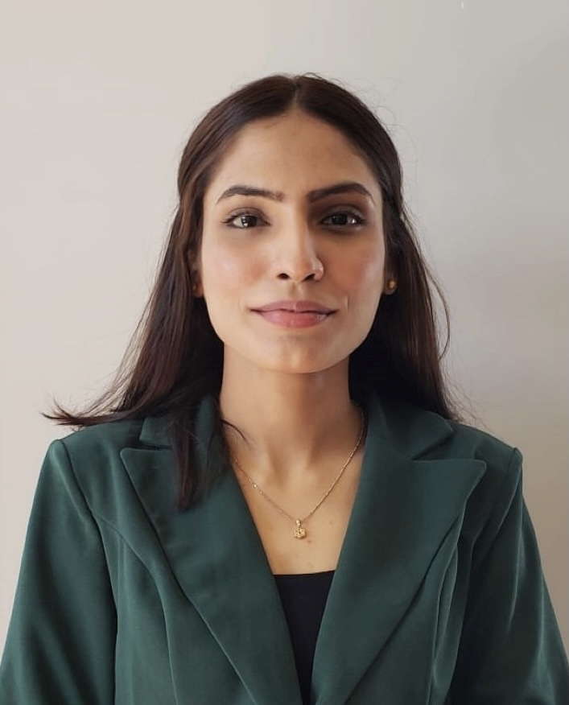
Your search ends here!
Let’s uncover, why you should hire Ayesha Fatima
Schedule a call

Slide 2
Profile Summary
With over eight years of experience in diverse sales and client-facing positions, I possess strong problem-solving skills, leadership abilities, and a growth-oriented mindset. I have consistently pursued certifications and remain dedicated to continuous learning and professional development. Demonstrating resilience is a key attribute in my professional approach.
Education
Master of Business Administration- Management
New York Institute of Technology
GPA: 3.54/4

Slide 3
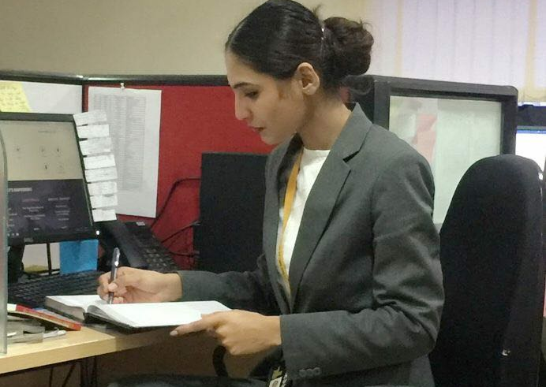
Worked in Various Industries and boosted sales & new business strategies:
Types of Sales & Activities (Business to Business & Business to Consumer)
Insurance Sales
Ad Sales & Marketing
IT Sales
SaaS Sales
Mobility Sales
Home Services
Retail

Slide 4
8+ Years of Experience
Company
Role
Harry Rosen Inc.
Customer Service Lead- Operations- 2023- Present
Customer Service Representative 2022-2023
Black and Lee- Tuxedos & Rentals
Sales Associate- 2022
NAMO e-waste Management Ltd.
International Business Development Representative- 2022
The Acquisition Group
Senior Marketing Consultant- 2021- 2022
Junior Marketing Consultant 2021
Cognitive Innovations Labs Pvt. Ltd.
Investor Relations Analyst – 2019- 2021
The Dollar Business- Vimbri Media Pvt. Ltd.
Assistant Manager- Creator EXIM Opportunities- 2017- 2019
Senior Marketing Consultant- Ad Sales & Marketing 2016- 2019

Slide 5
Certifications
Technical Skills
Bloomberg-> Bloomberg Market Concepts
Coursera-> Foundations of Project Management by Google
HubSpot Academy-> Content Marketing Certification
Social Media Marketing
LinkedIn -> Building Rapport with Customers
Customer Service Foundations
Critical Thinking for More Effective Communication
Root Cause Analysis
Advanced Data Visualizations- LinkedIn
Safe Space- > Suicide First-Aid Certification
Adobe
ZOHO
CANVA
JESTA
SQUARESPACE
Webador
WIX
Hootsuite
HubSpot
ASANA
Mailchimp
ALEXA

Slide 6
Achievements
SKILLS
Interpersonal Skills
Negotiation
Cold Calling & Generating Leads
Critical Thinking
Team Management
Sales & Customer Service
Recognised as the 'Senior Marketing Consultant of the Year' for 2021 at The Acquisition Group
Participated in the Round Table for the prestigious 'International North-South Transport Corridor' organised by the Russian Federation
Participated in 'Analytics in Marketing'(AIM 2019) organised by TICKER India 2019
Anchored and hosted The Dollar Business- Summer Edition Conclave in 2016

Slide 7
Let’s talk about how I can be an asset!
Transferable skills: My experience has put together a diverse range of skills that I can apply to various industries. I am a quick learner, adaptable, and well-versed in transitioning my skills to new challenges.
Attention to Detail: In any role, the key to success is attention to detail. I consistently thrive with a keen eye for detail, ensuring accuracy in communication, order processing, and client interactions. This approach contributes big time to minimise errors and fostering positive customer experience.
Sales Expertise: With a solid foundation in Sales, I have honed my ability to pursue and identify opportunities effectively. My sales experience includes meeting and exceeding sales targets, developing strategic sales plans, and consistently delivering results. I understand the importance of sales, after-sales, and indirect sales. Regardless of the type, I believe in maintaining a customer-centric approach because it is what drives growth and revenue for an organisation.
Excellent Interpersonal Skills: I pride myself on my ability to connect with clients, understand their needs, and foster trust by building strong and lasting relationships. It has proven that these relationships not only contribute to short-term success but also lay the foundation for long-term partnerships.
Hunger to Learn: I have a strong appetite for learning and staying in touch with industry trends. I work calmly under pressure and learn more through the experience which helps me apply acquired skills to the next task. This hunger for knowledge keeps me well informed and positions me to adapt to evolving market dynamics making me an asset to your team.

Slide 8
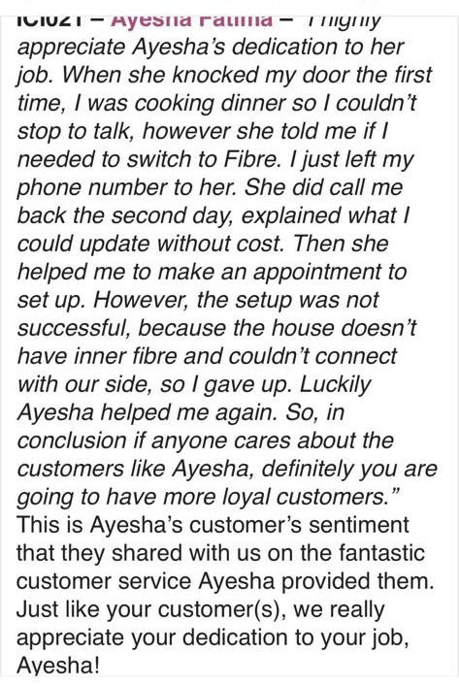
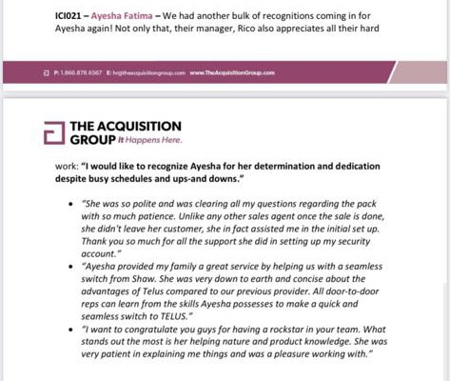
I strive to bring out the best in people, don’t just take my word for it

Slide 9
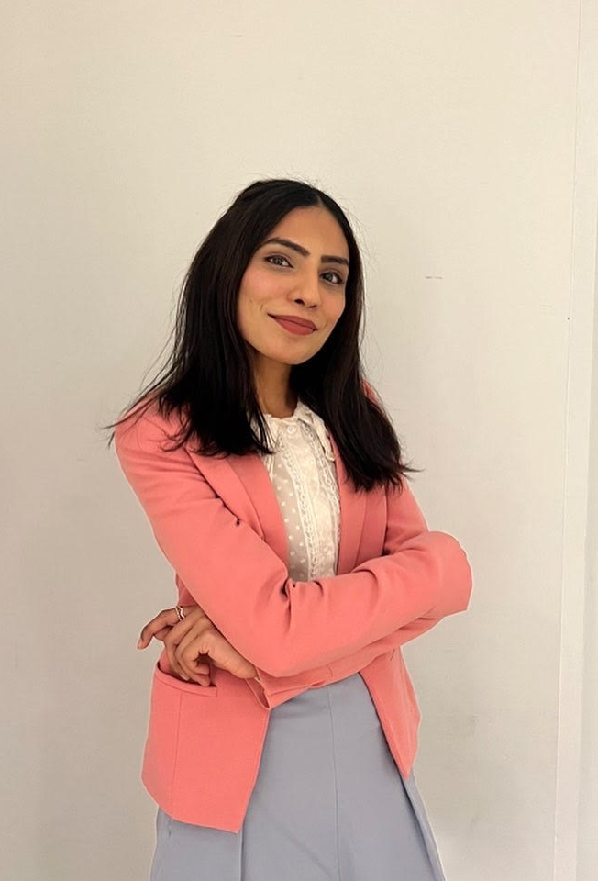
Those were just a few reasons. Let’s talk more about how I can contribute to your organisation!
Cell: + 1 236 591 2276
Email: ayeshaafatima222@gmail.com
LinkedIn: https://www.lin﻿kedin.com/in/ayesha-fatima94

